Slide 1



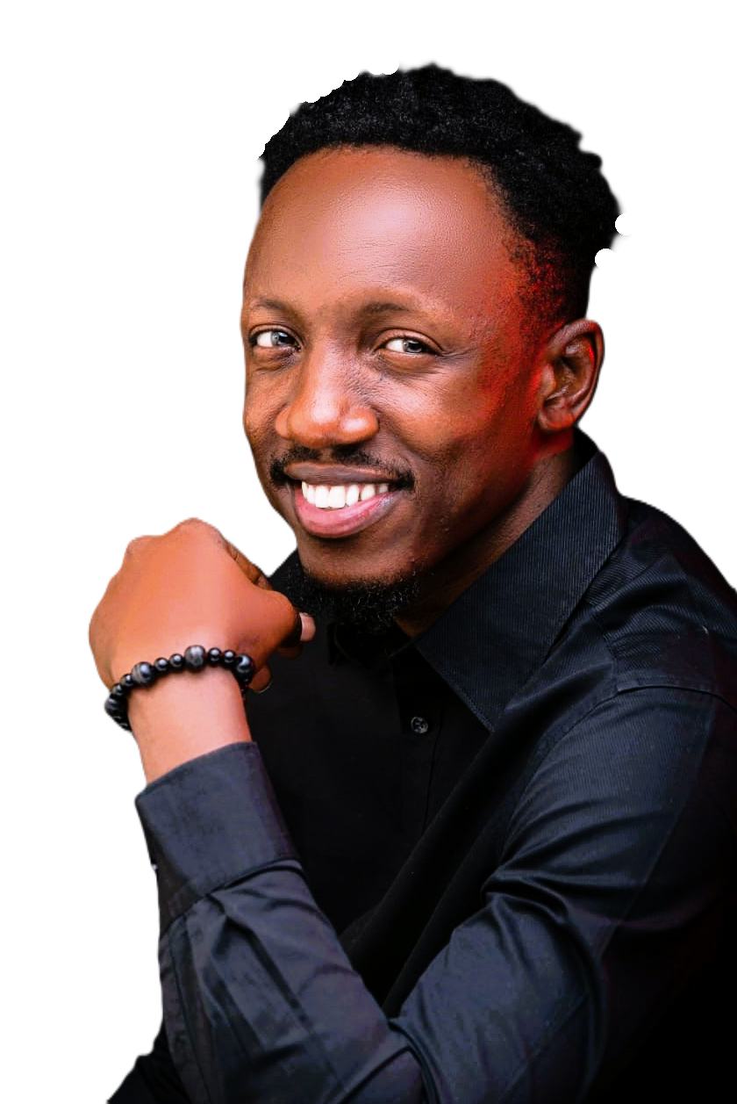
Henry Okeke, popularly known as HenrySmartMoney, is a copy trading expert, market strategist, and trusted trading mentor with over a decade of experience in the financial markets.
Renowned for delivering data driven market insights, proven trading strategies, and disciplined risk management, Henry has helped traders navigate market opportunities with greater confidence and consistency.
In this session, Henry will share practical strategies and actionable insights to help traders build a smarter approach to the markets and work toward achieving their financial goals.
HENRY OKEKE
FINANCIAL ANALYST.

Slide 2

Leveraging on the skill
of others to survive hyper inflation
More Than Trading

Slide 3


WHY LEVERAGE IS IMPORTANT
A strategic advantage
Taking maximum advantage of an available and accessible resource or opportunity
More Than Trading

Slide 4
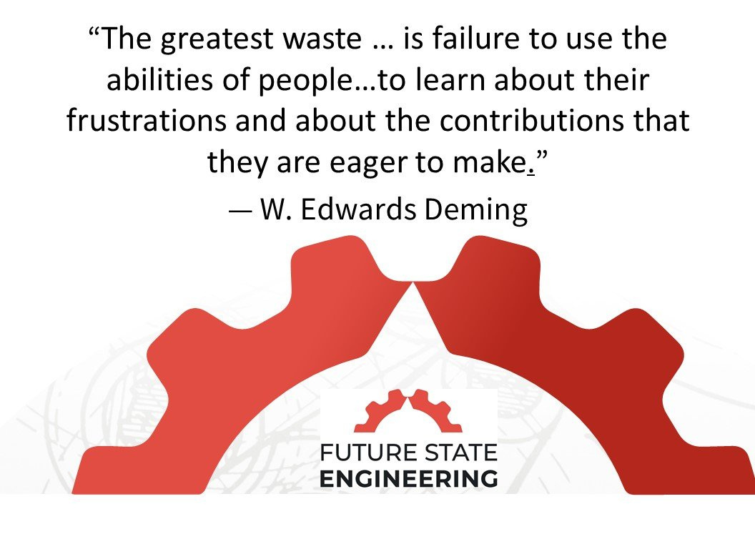
More Than Trading

Slide 5
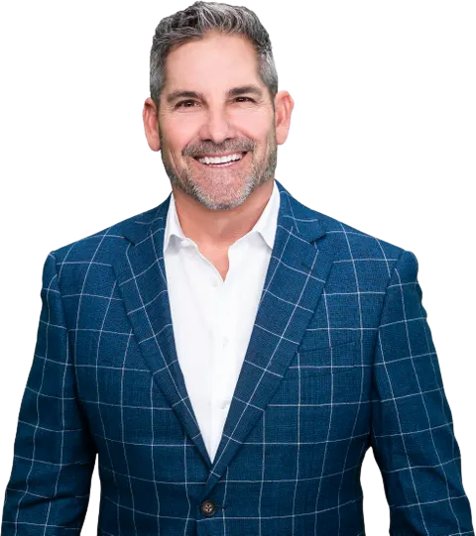
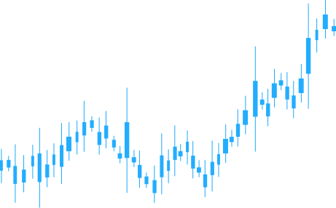
SUCCESS
IS NO DIFFERENT
THAN ANY OTHER SKILL
DUPLICATE THE ACTIONS AND MIND-SETS
OF SUCCESSFUL PEOPLE, AND YOU WILL
CREATE SUCCESS FOR YOURSELF.
GRANT CARDONE

Slide 6

More Than Trading

Slide 7
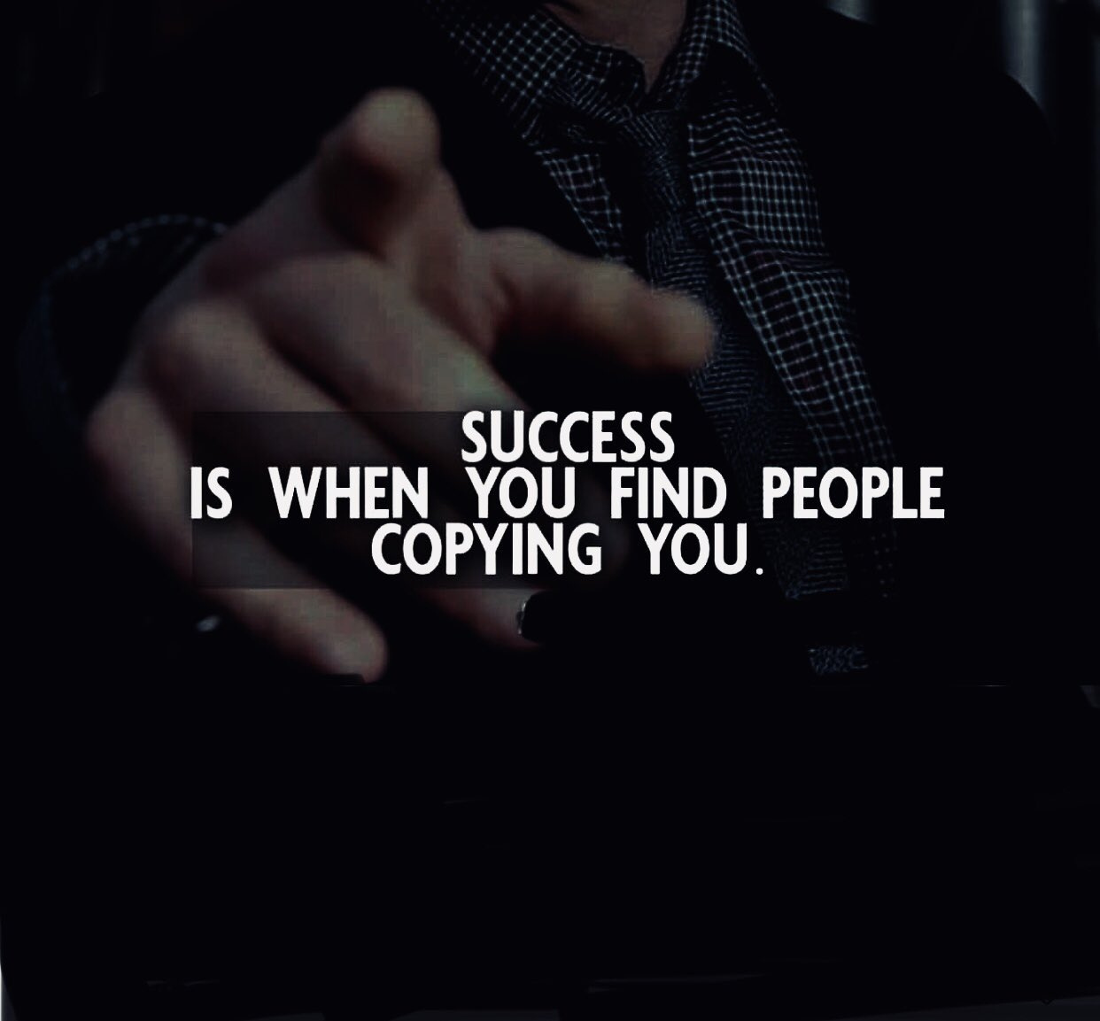
More Than Trading

Slide 8


Slide 9
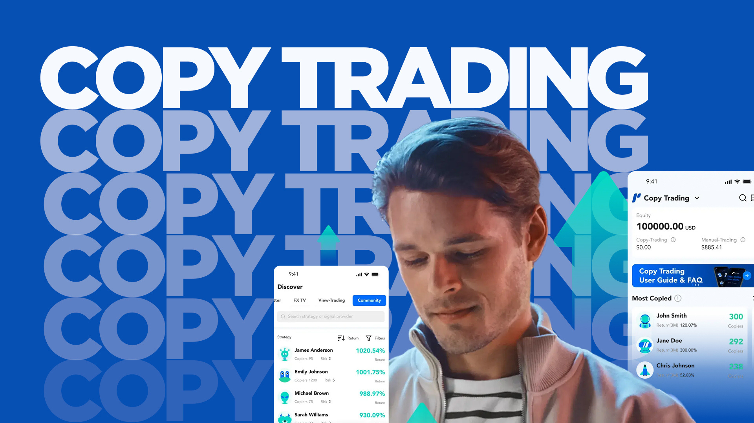

Slide 10

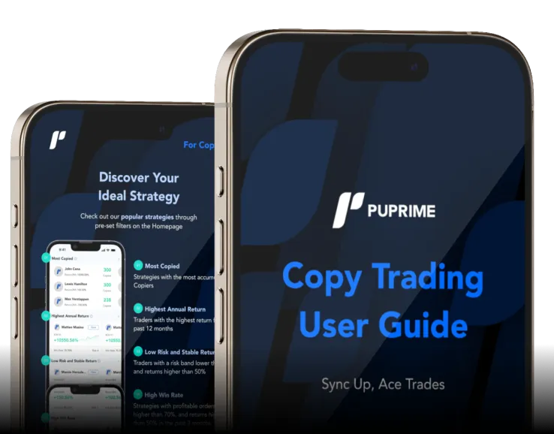

Slide 11

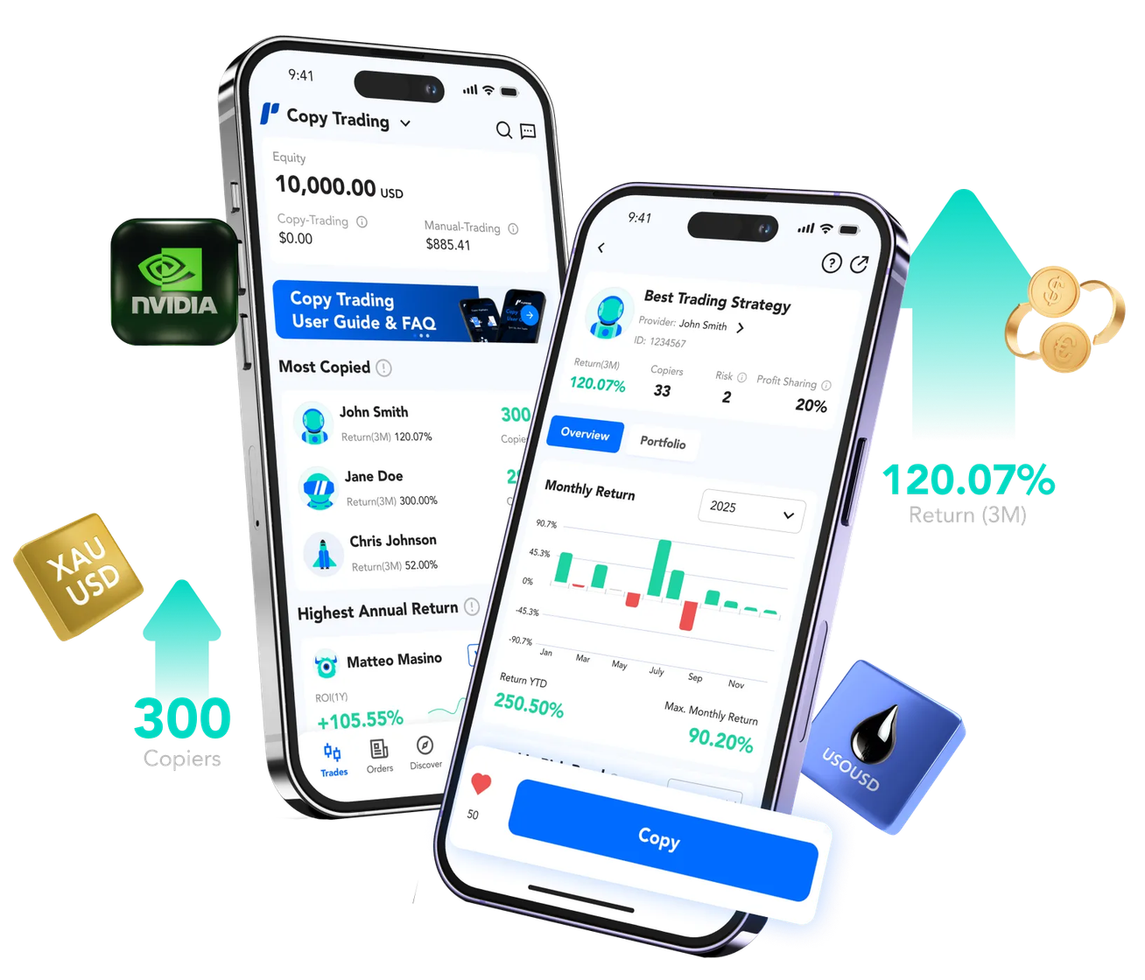

Slide 12
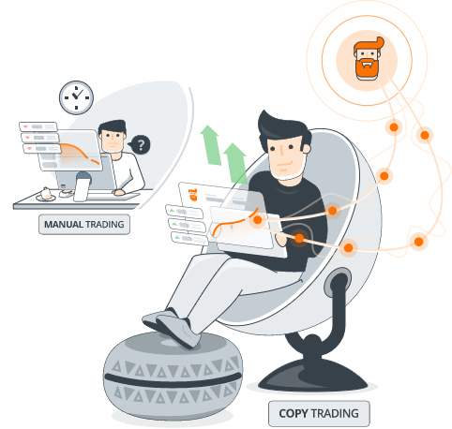
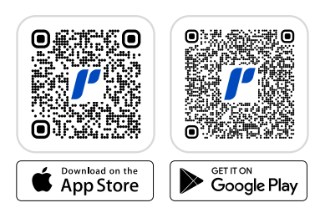
WHAT IS COPY TRADING???
Copy Trading is a trading strategy and function which automatically replicates the trades of experienced and successful traders. Individuals can potentially benefit from their expertise, insights, and strategies without requiring extensive trading knowledge or experience in the global financial market.
Copy trading is one of the easiest ways to use another traders expert knowledge.
You decide the amount you wish to invest and simply copy everything they do automatically in real time..

Slide 13
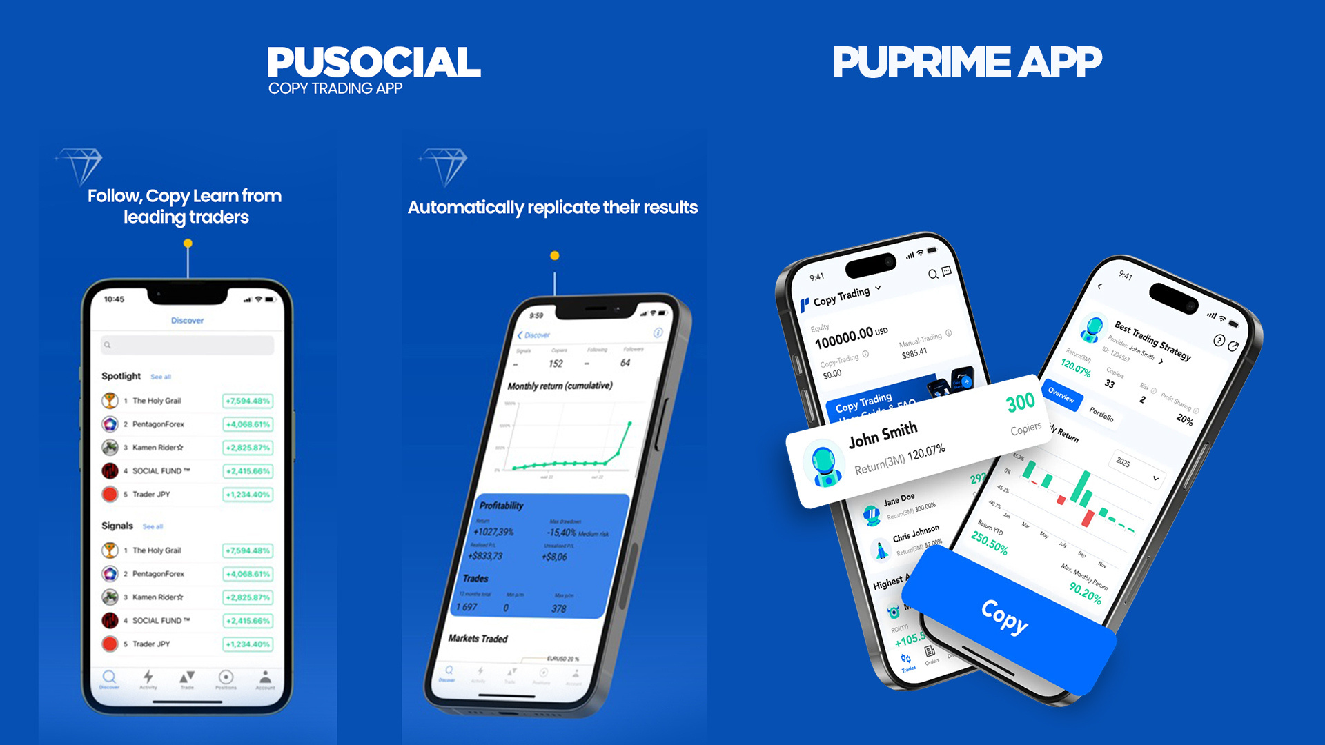

Slide 14


Slide 15
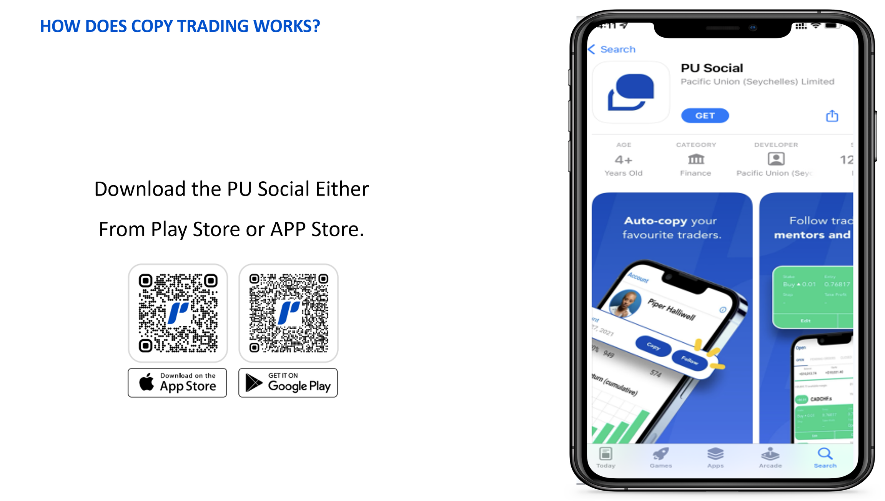

Slide 16
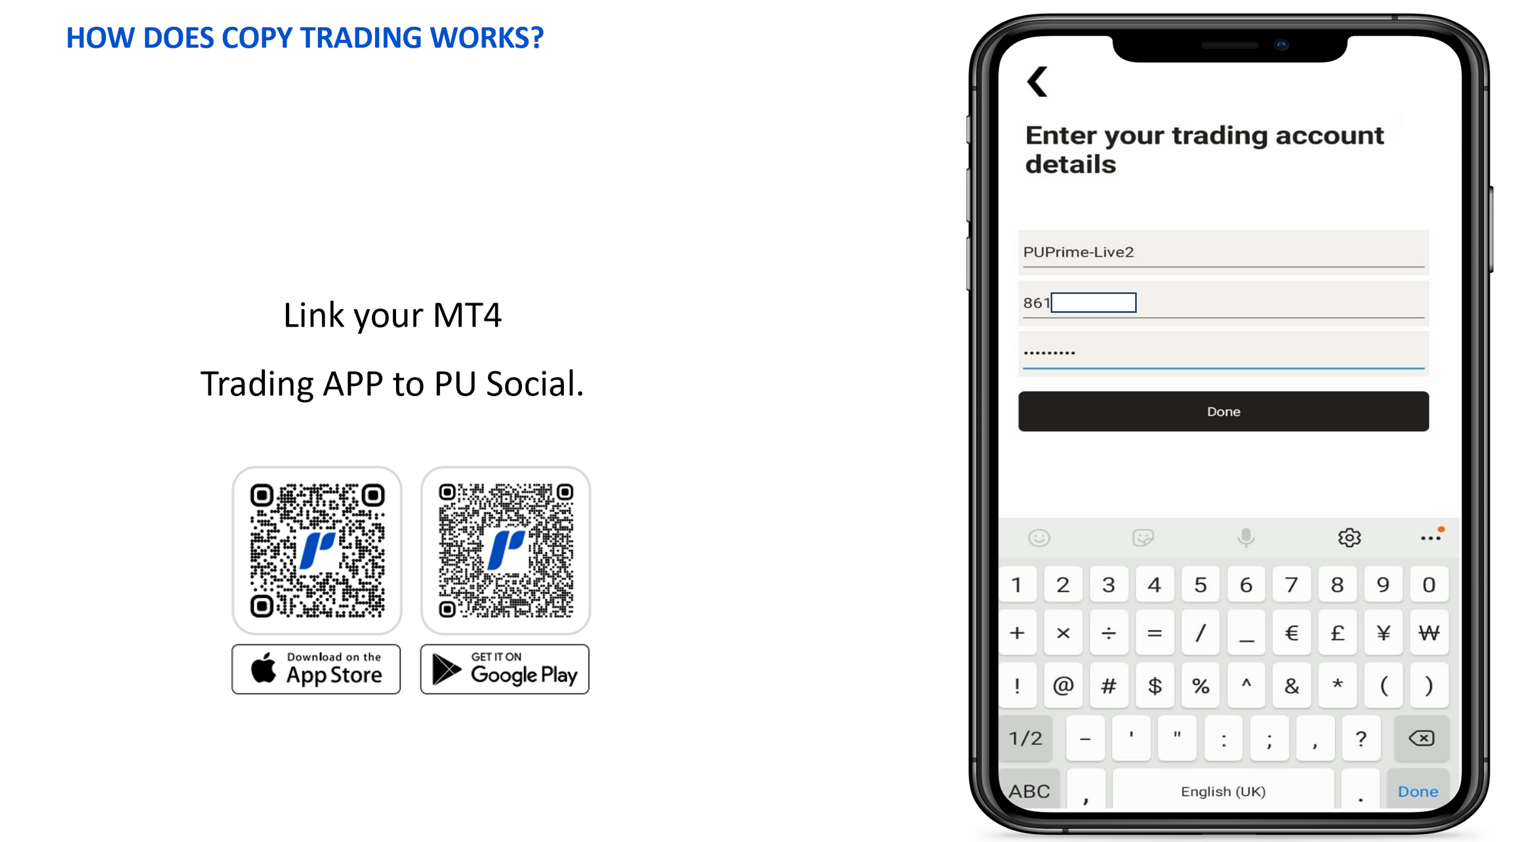

Slide 17
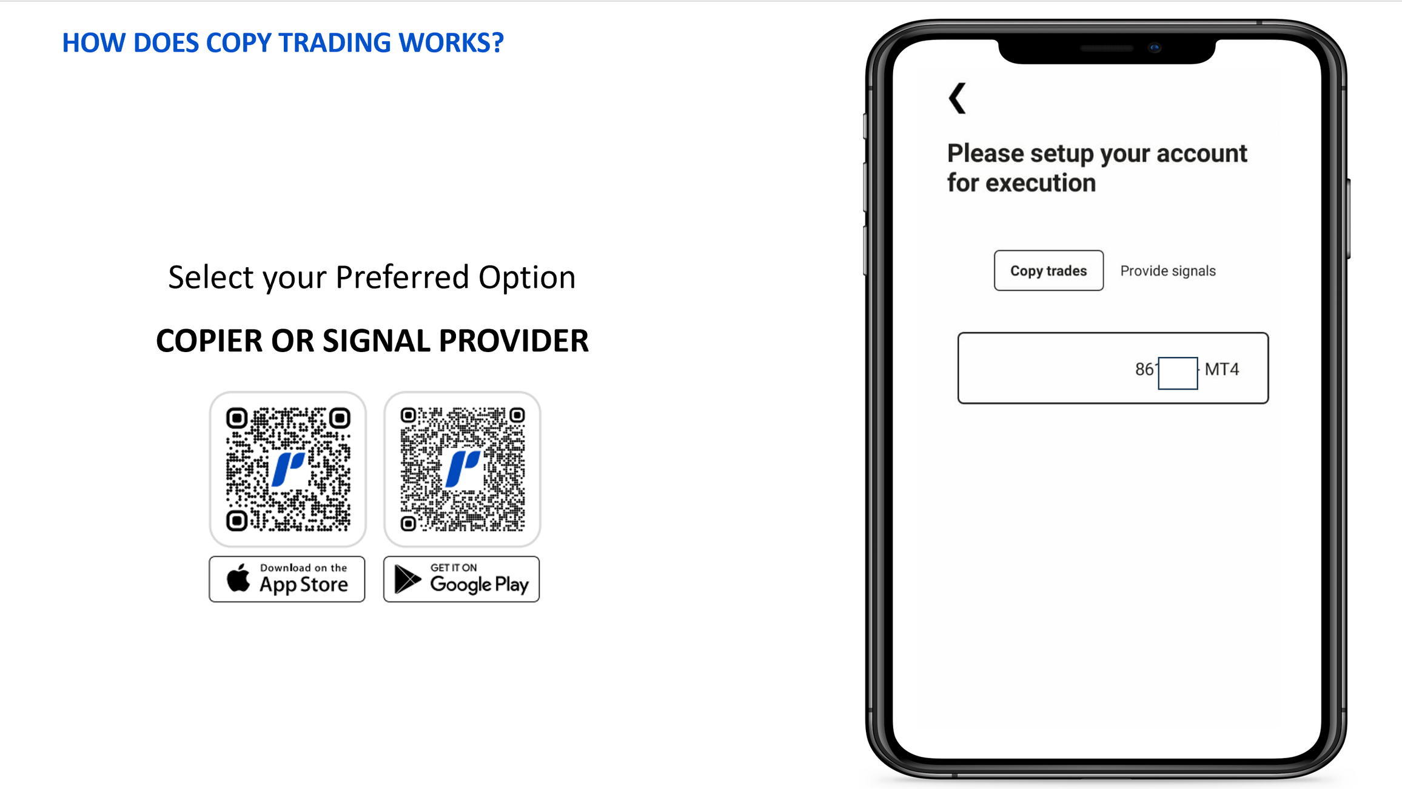

Slide 18


Slide 19
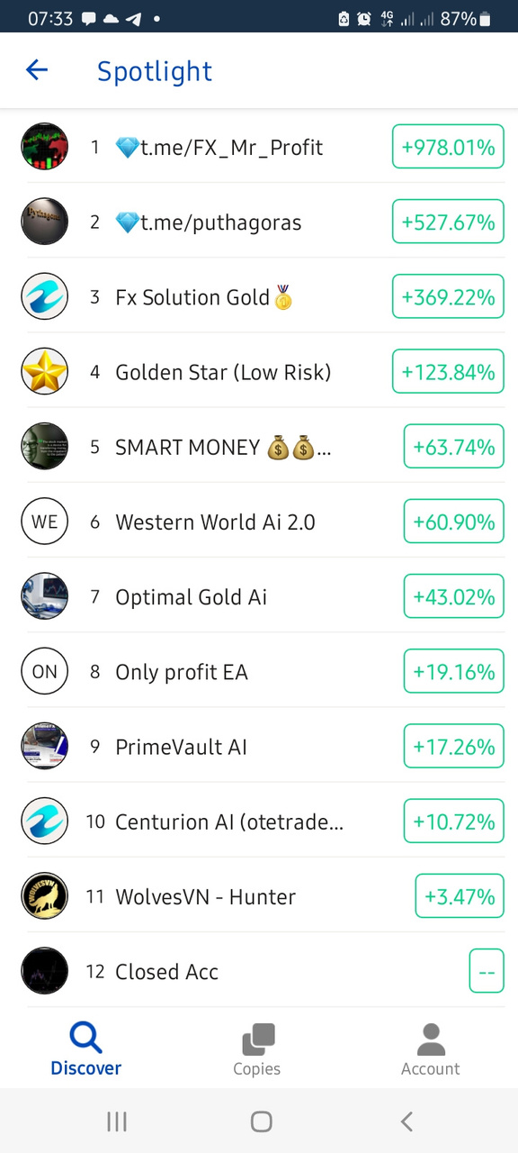
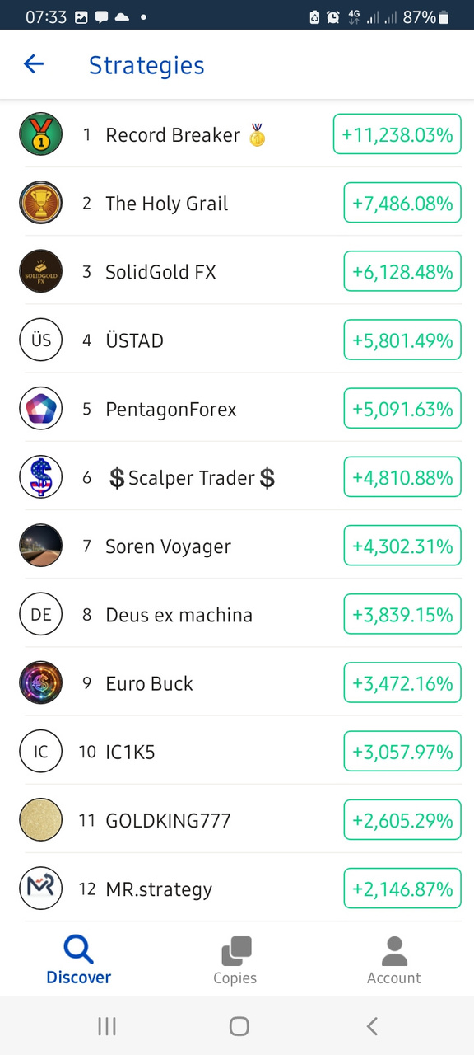
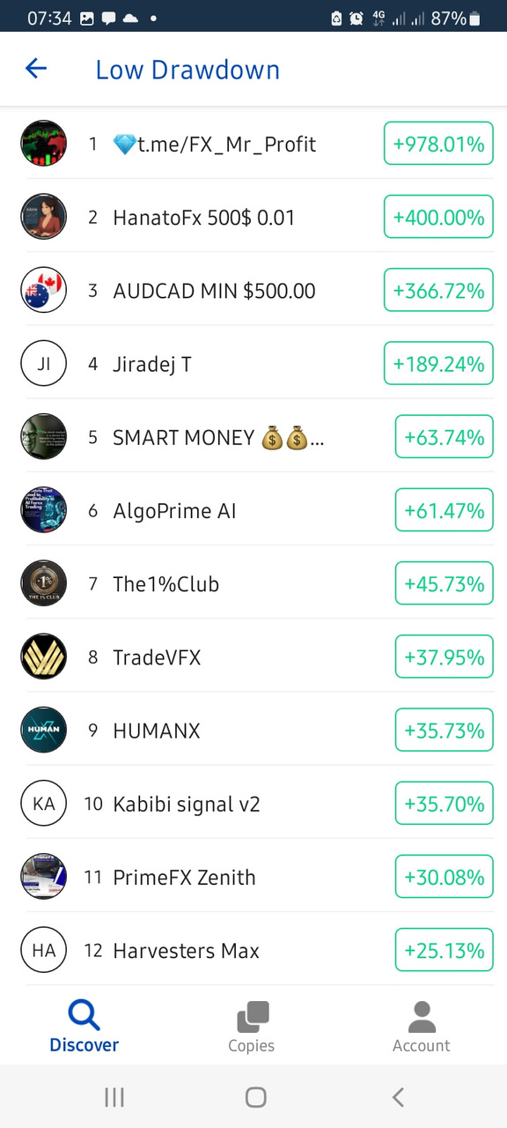
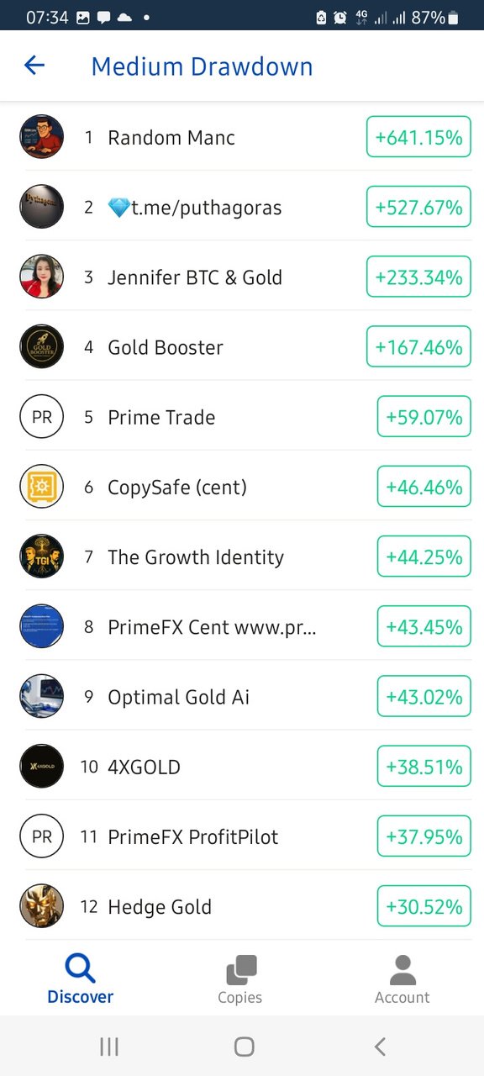

Slide 20
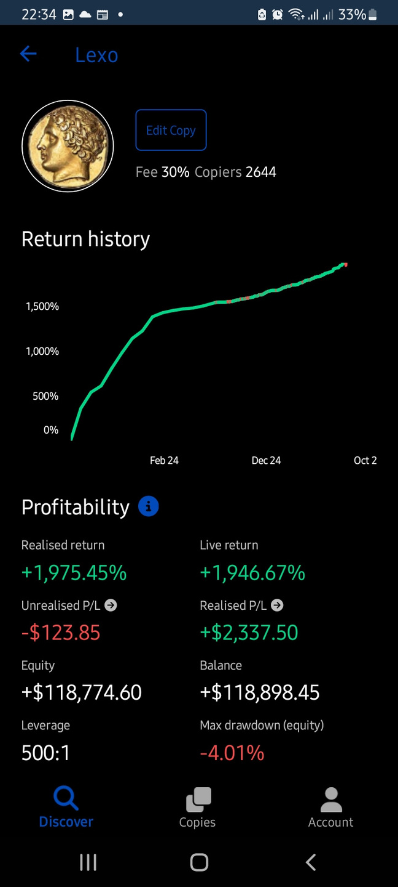
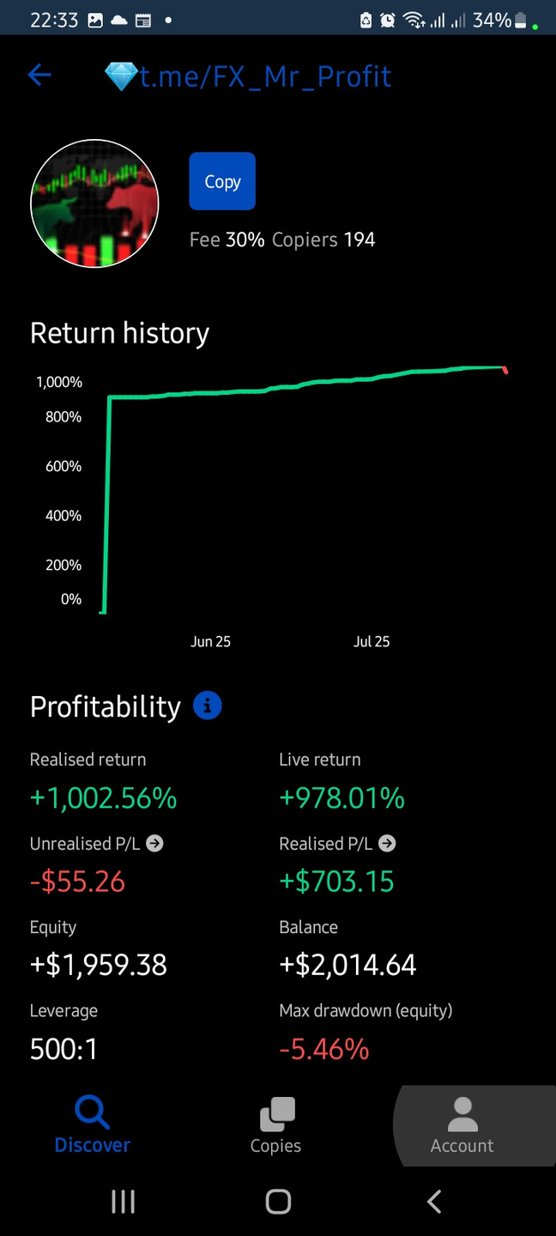
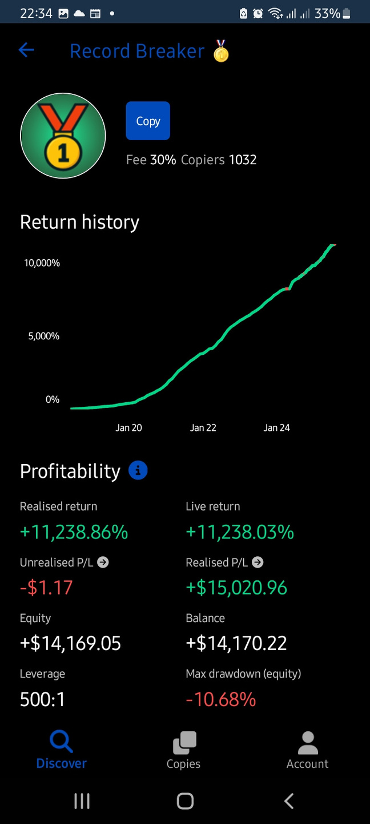
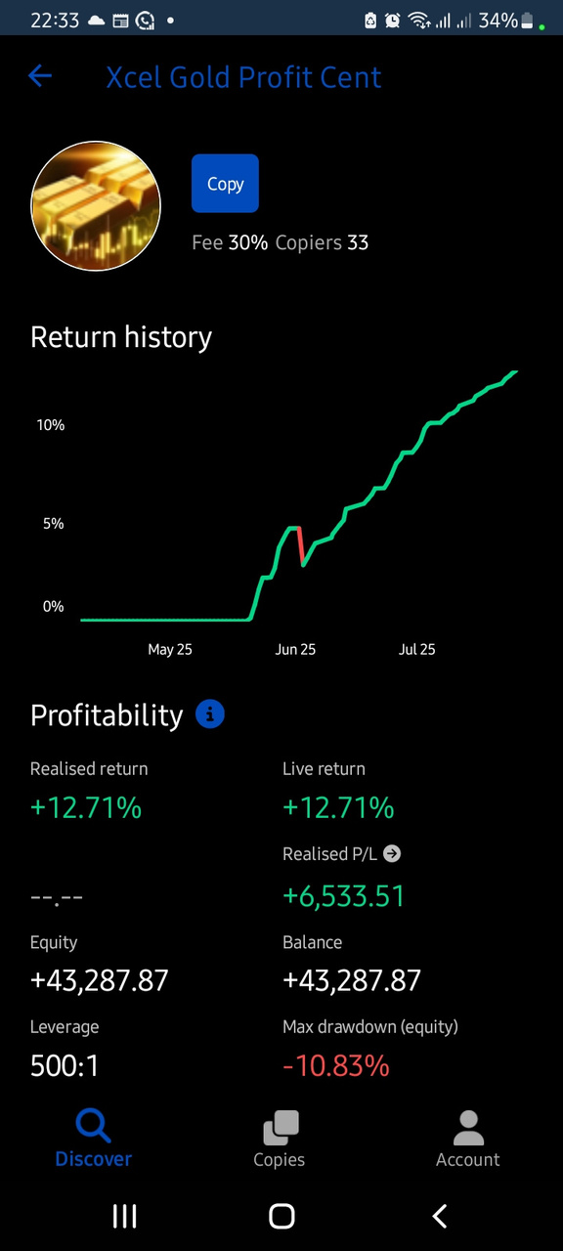

Slide 21
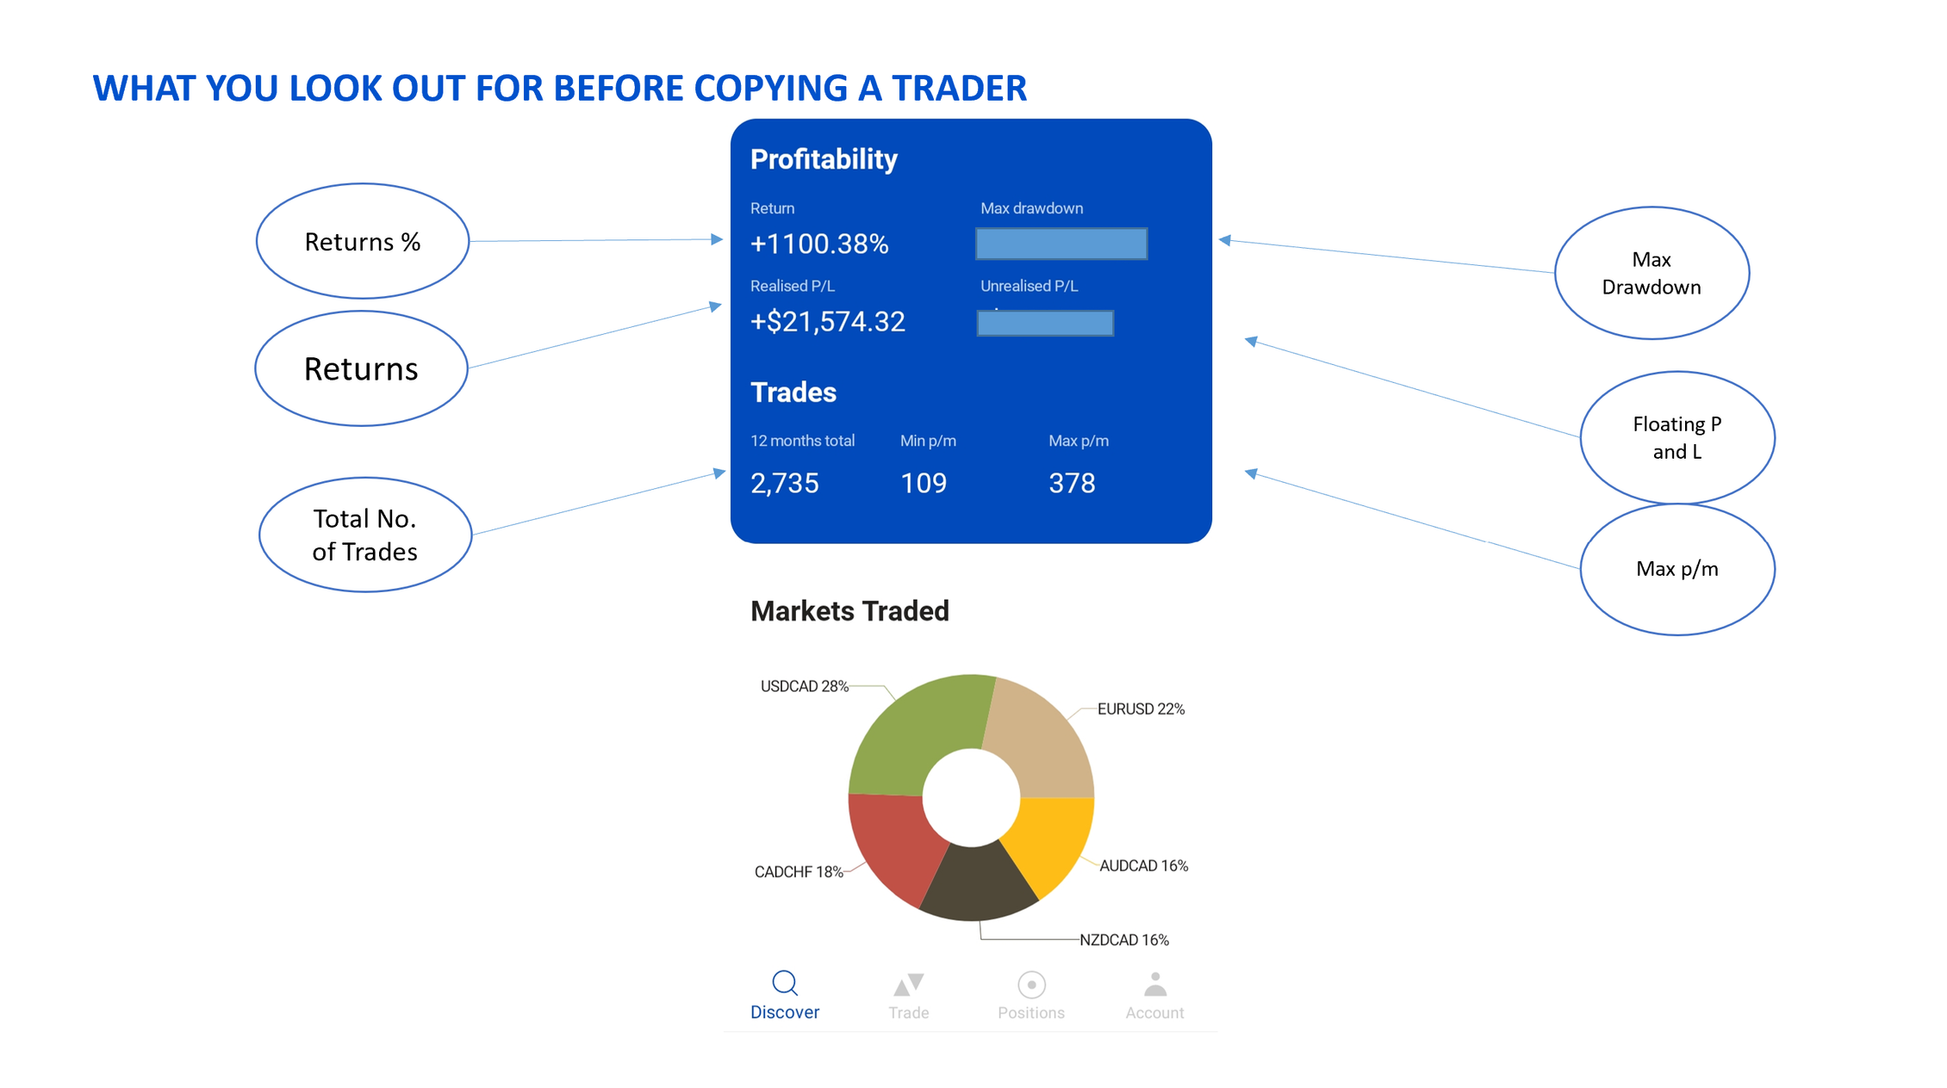

Slide 22


Slide 23
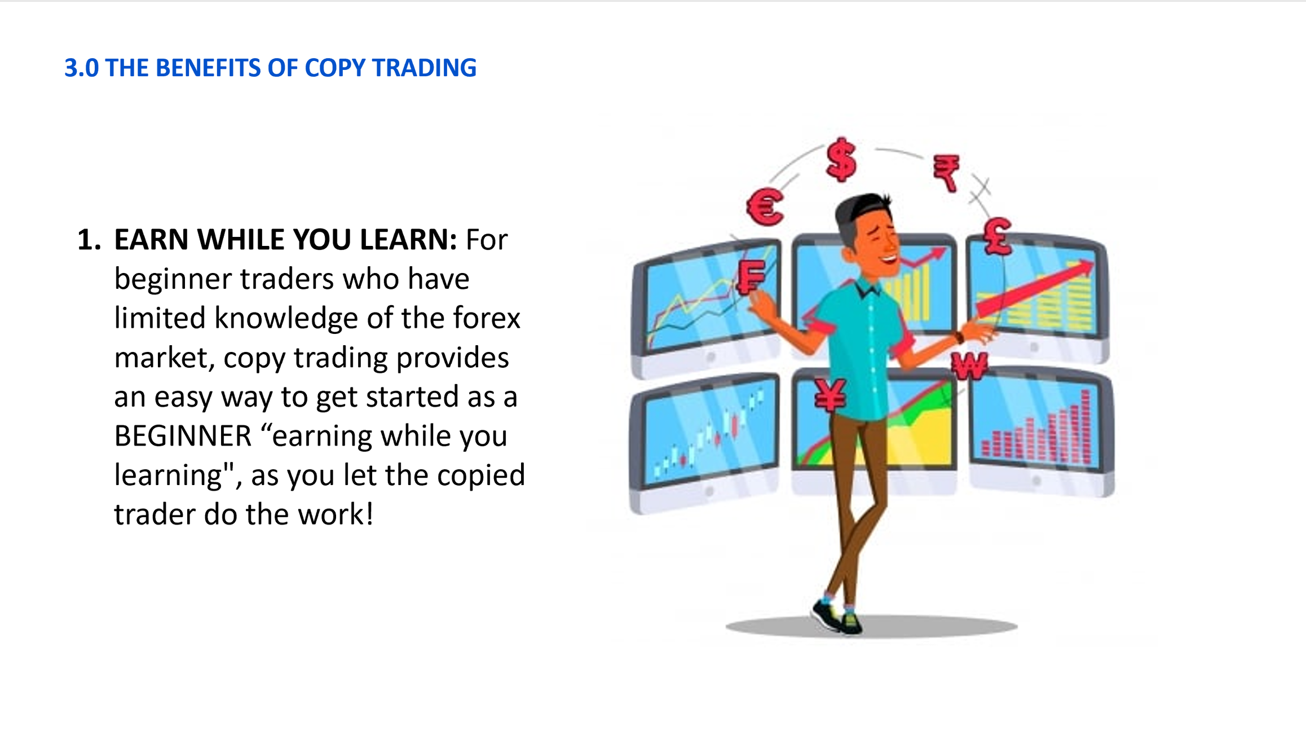

Slide 24
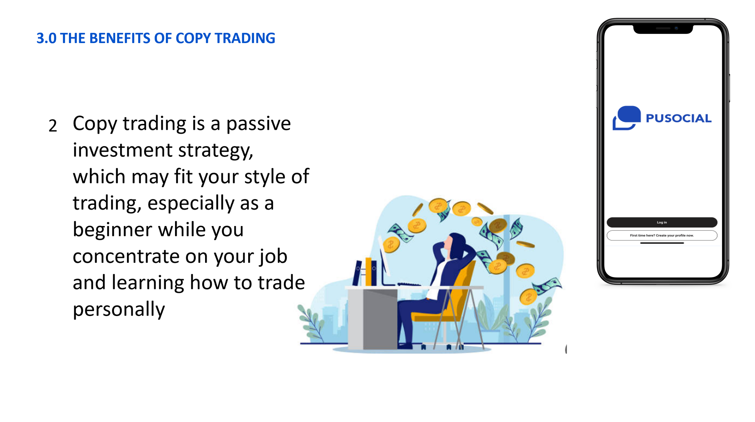

Slide 25
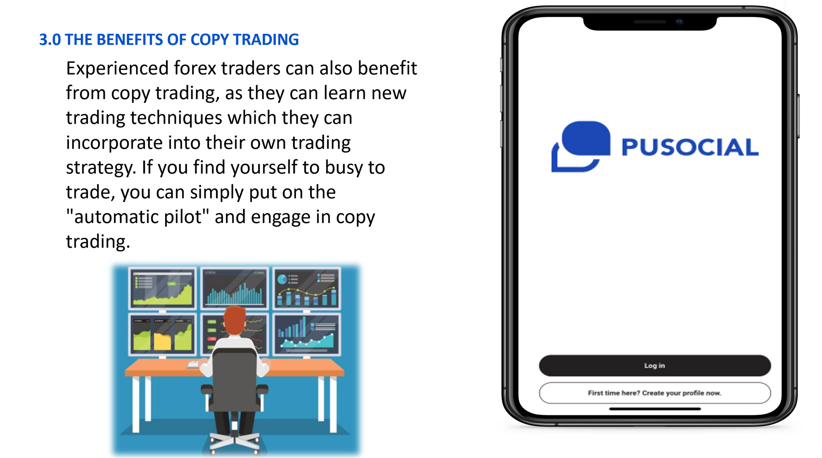

Slide 26
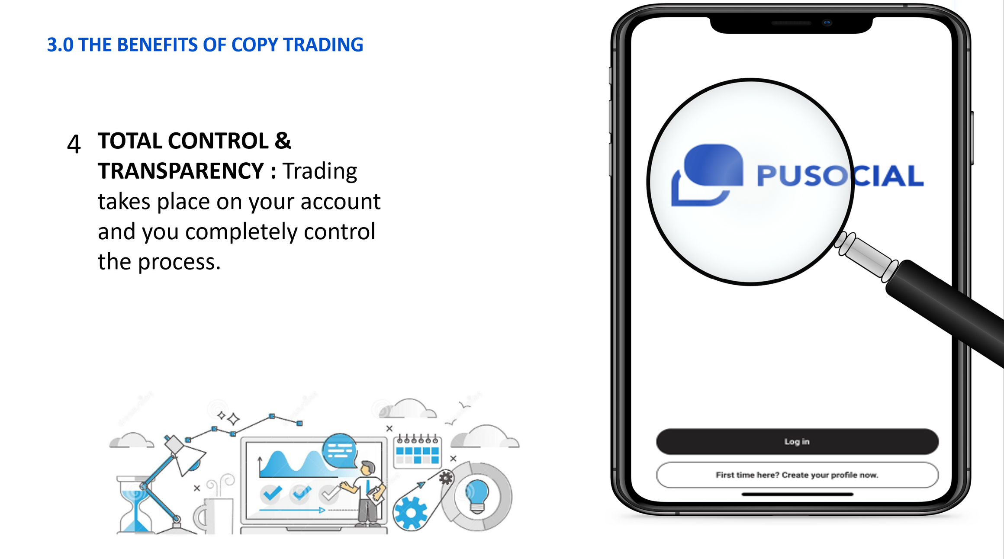

Slide 27
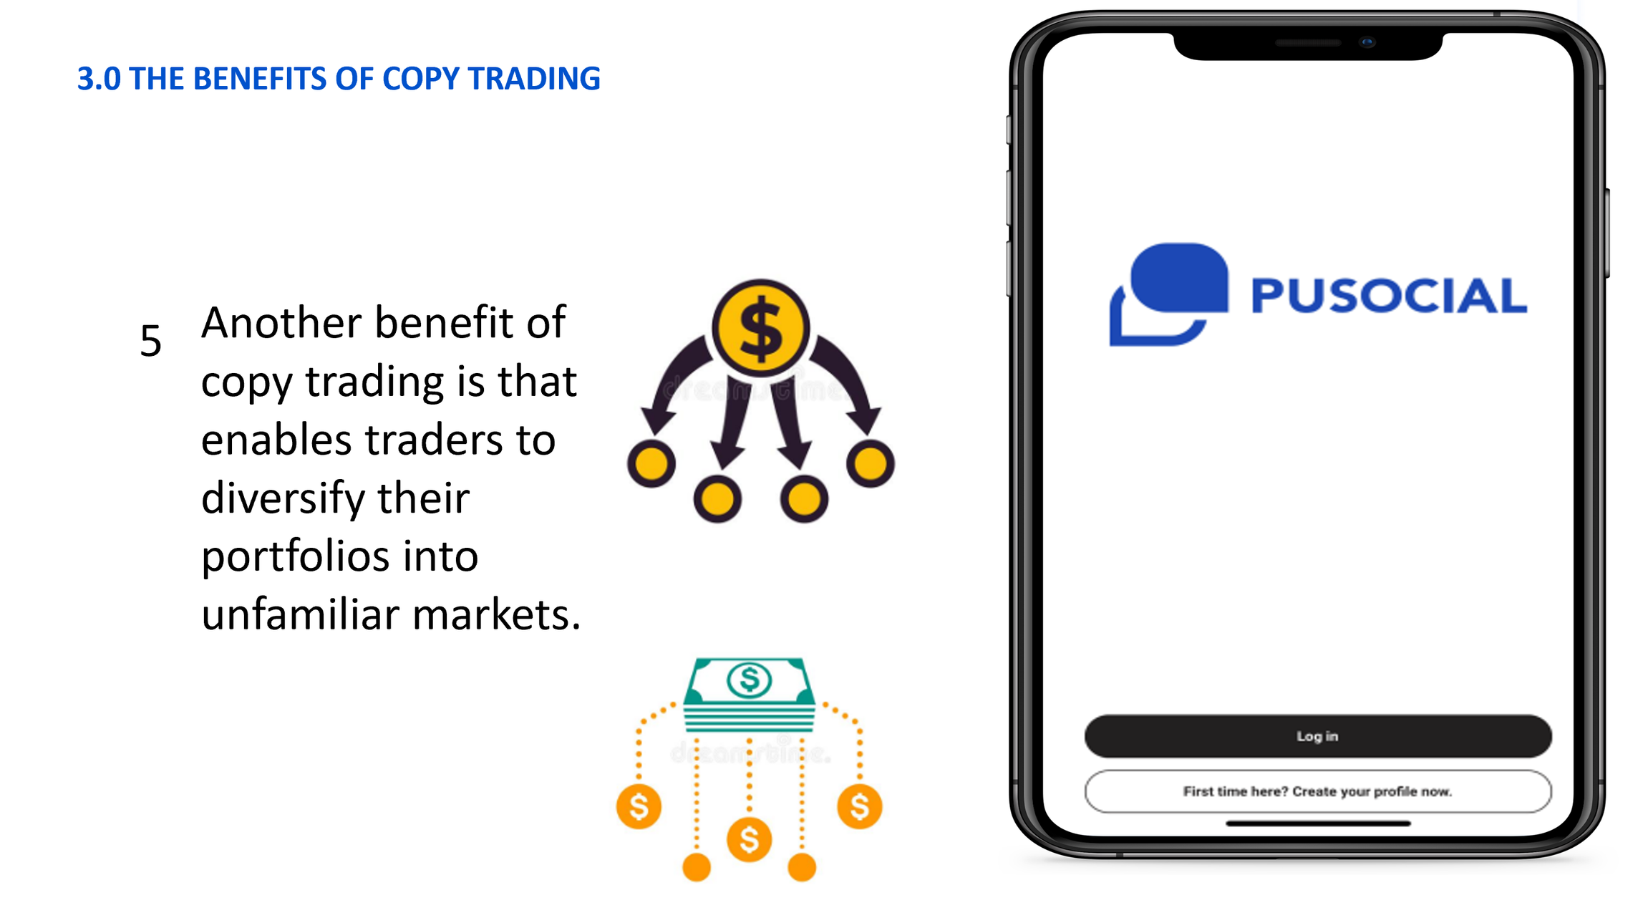

Slide 28
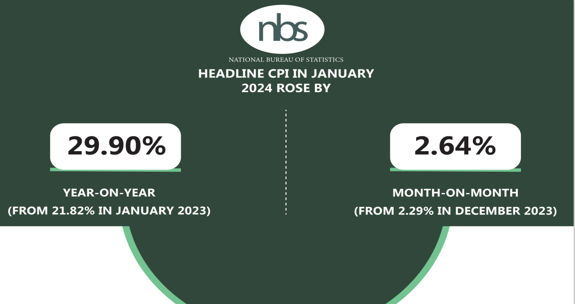
the headline inflation rate in January 2024 was 2.64%
LIVING ABOVE HYPER INFLATION

Slide 29
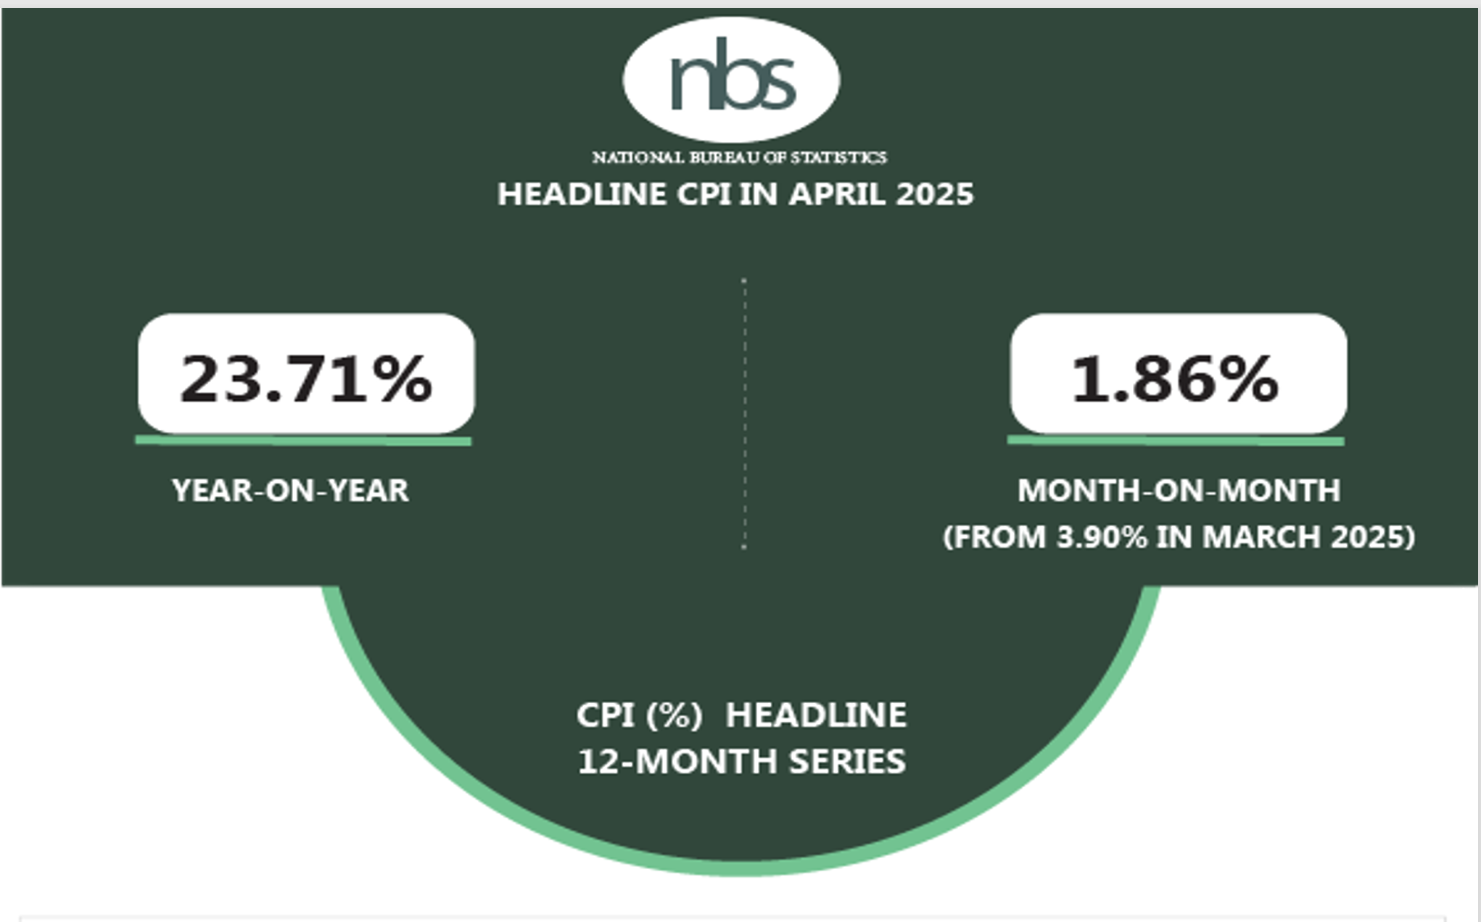

Slide 30


Slide 31
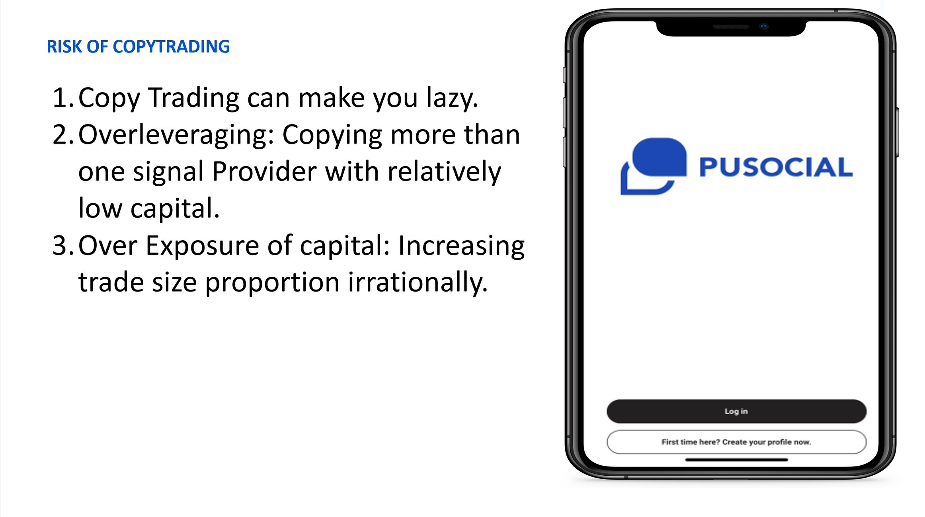

Slide 32
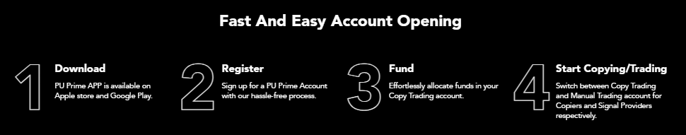

PU PRIME

Slide 33


Testimonials
1.

Slide 34
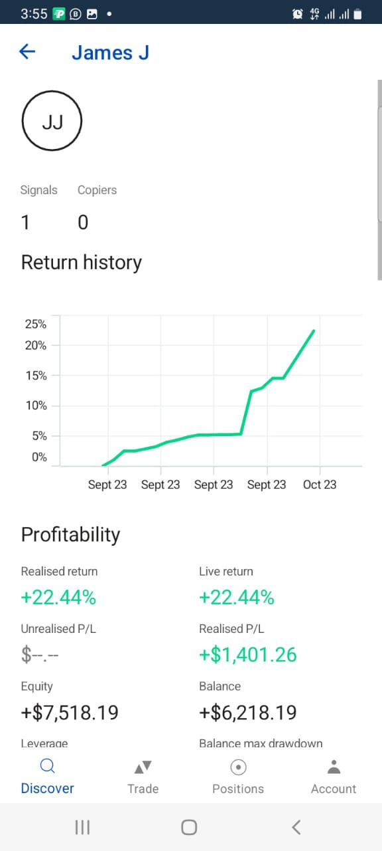
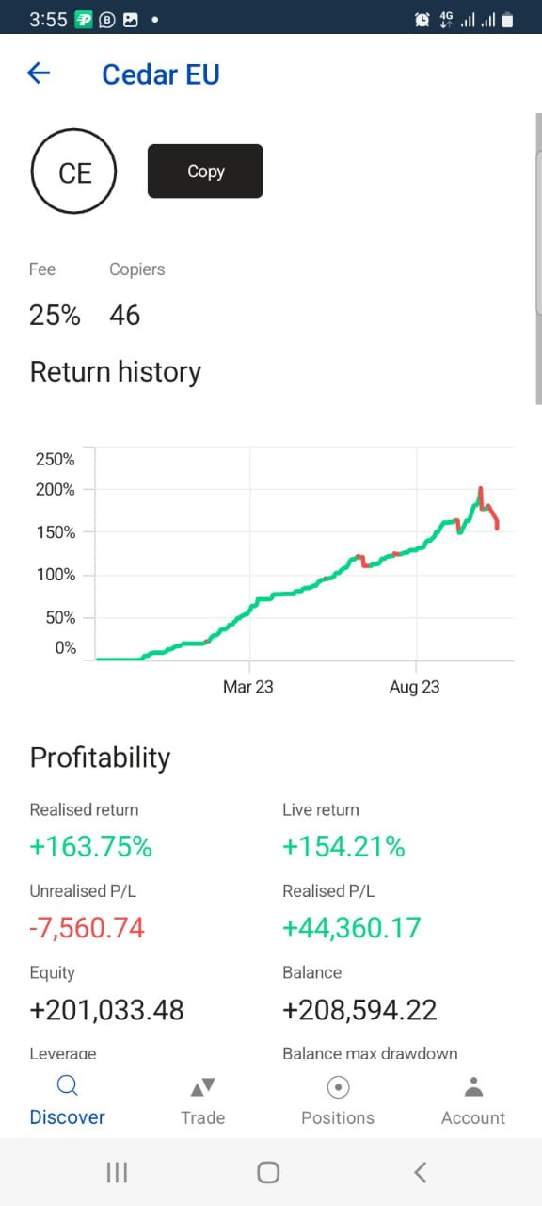
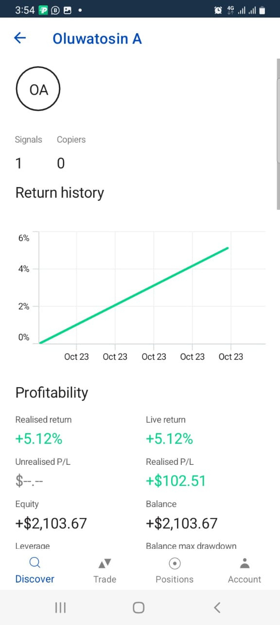
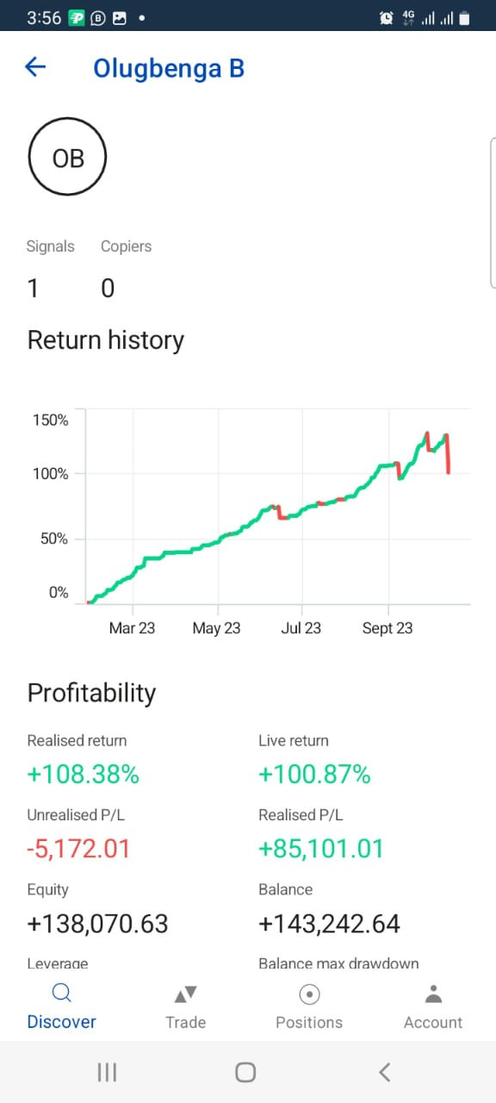
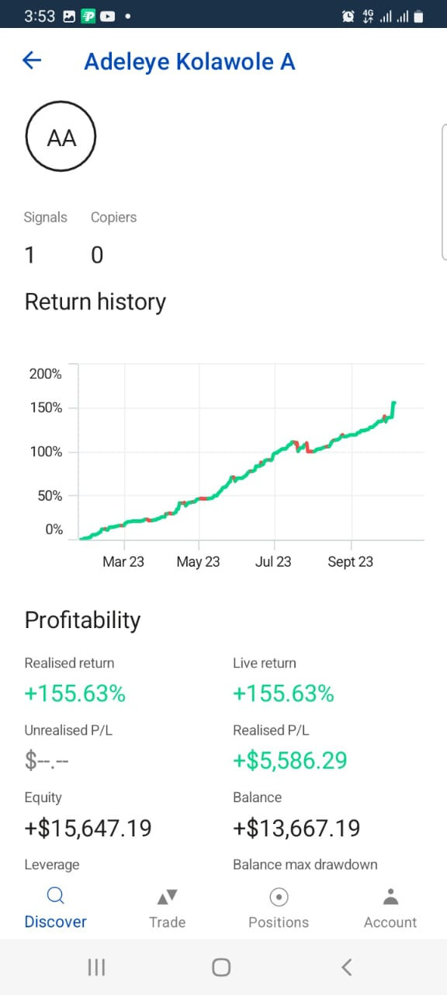
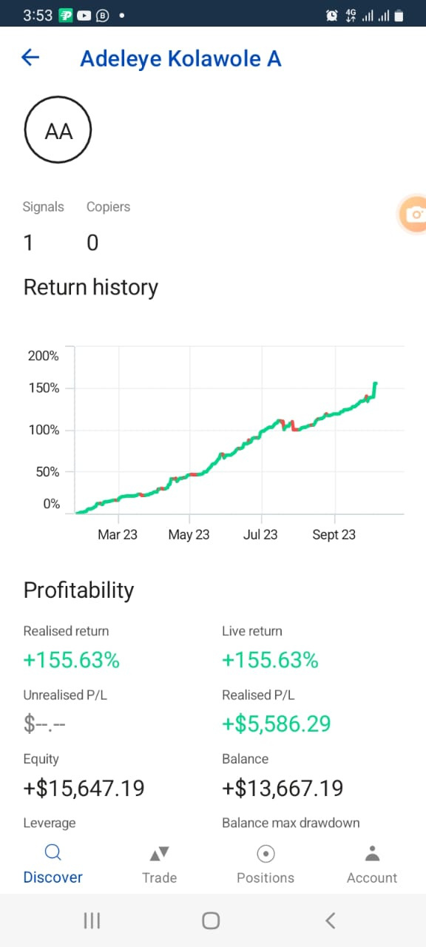

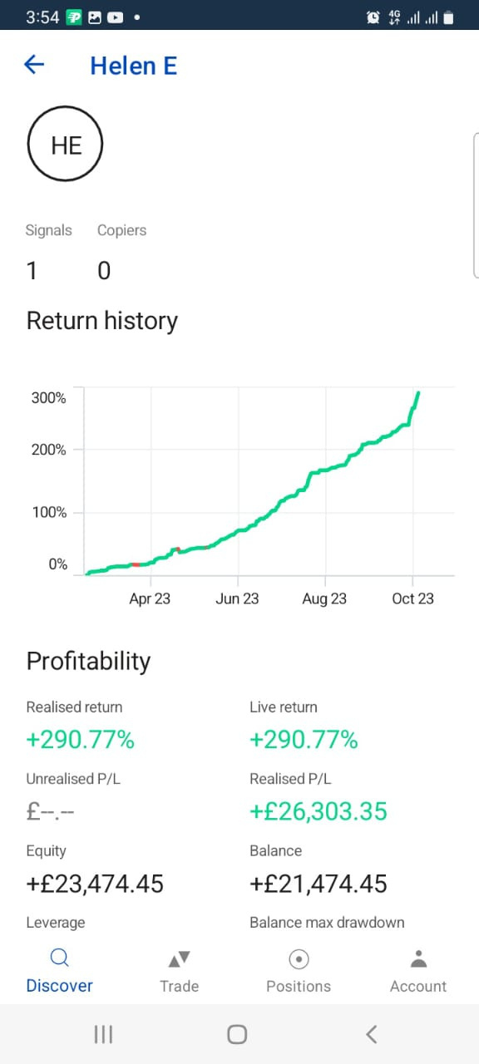
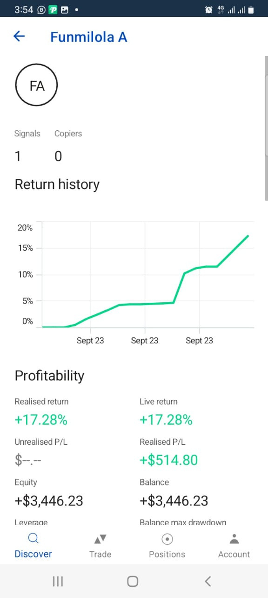

Slide 37
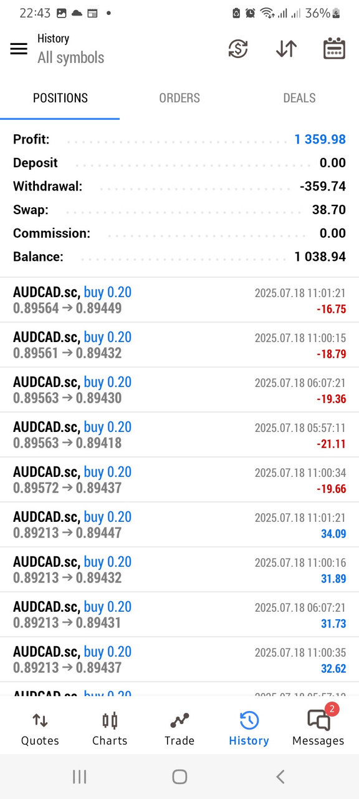
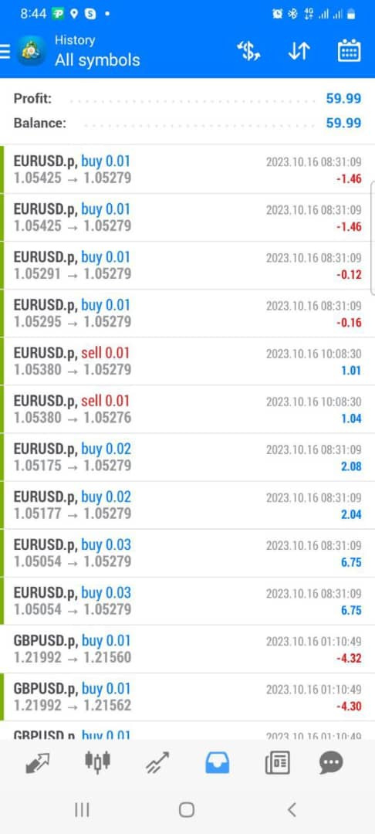
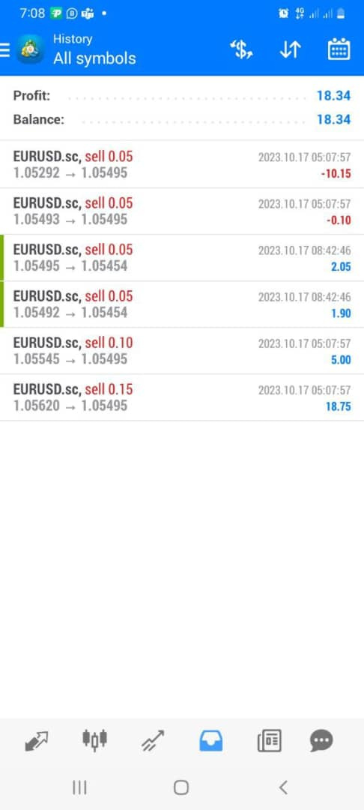
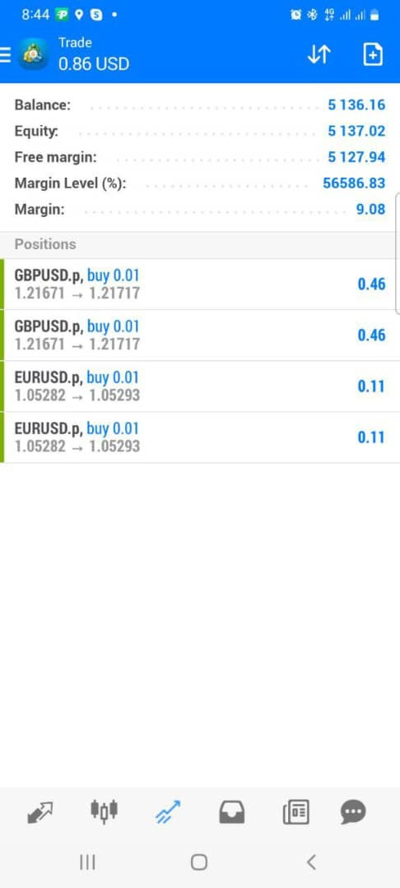
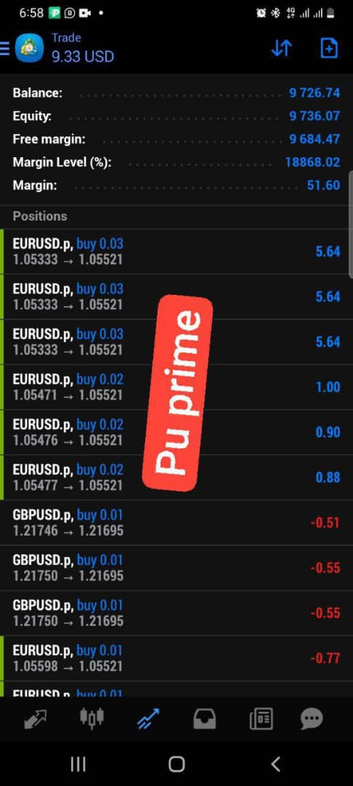
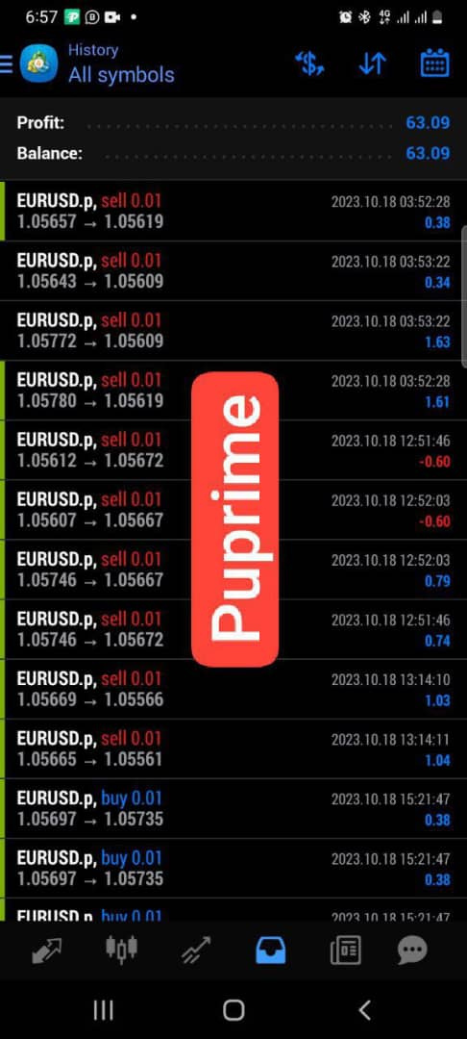
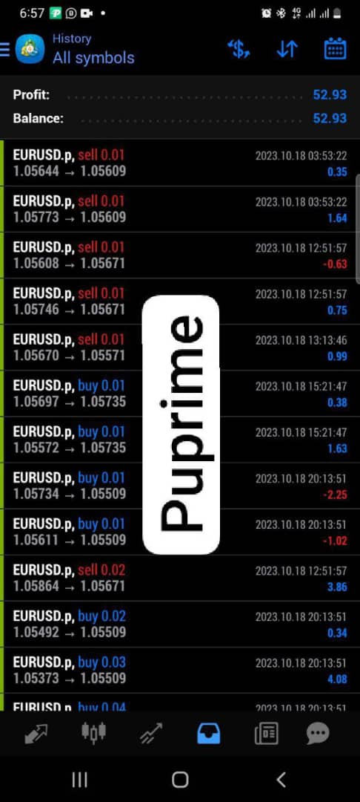
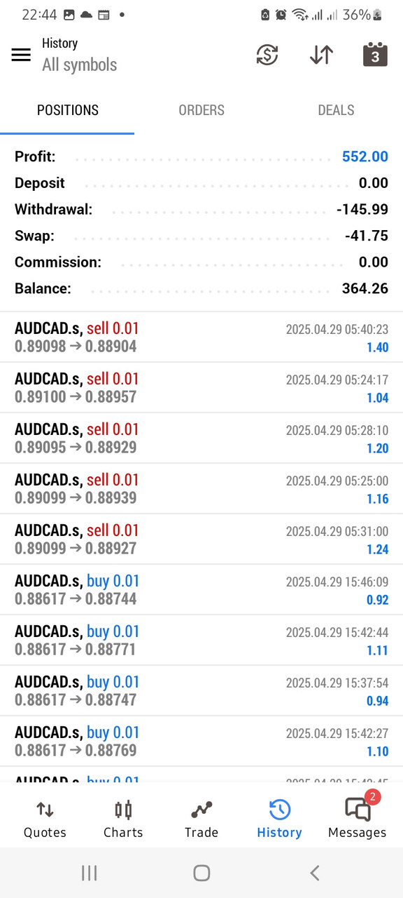
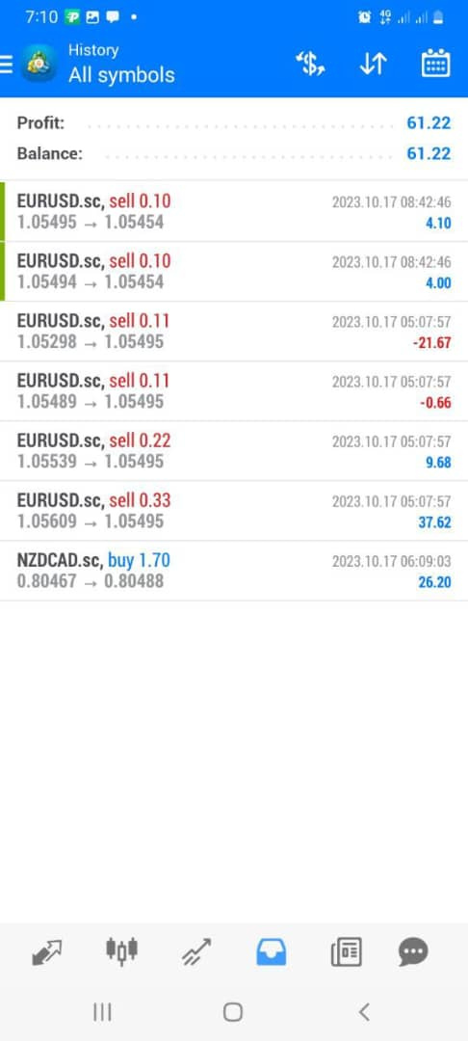

Slide 38
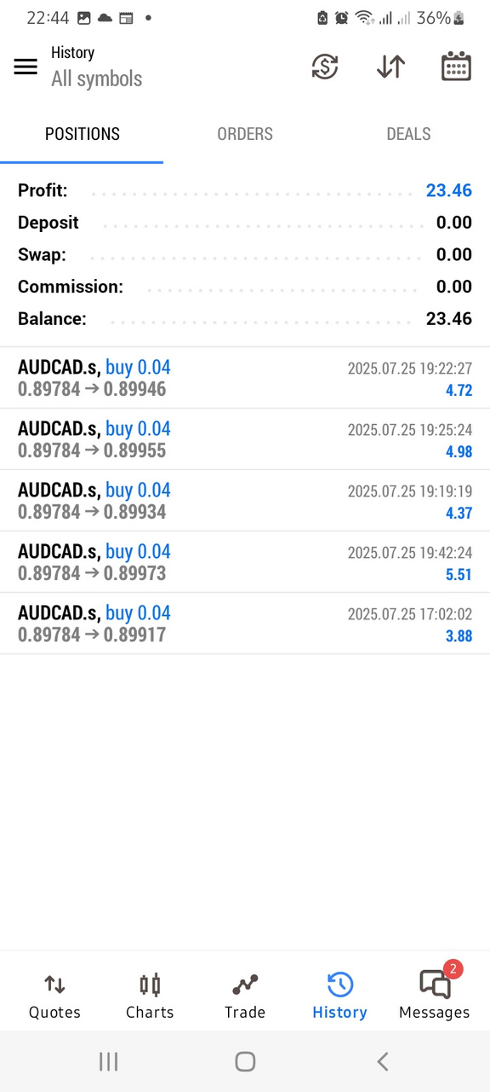



Slide 40
Come to the office for more

Slide 41

Thank you

